Slide 1
Peanut Butter and _________
Salt and _________
Bacon and _________
Spaghetti and _________
Macaroni and _________
Pen and _________
Needle and _________
Bow and _________
Batman and _________

Slide 2
Love and Truth

Slide 3


Slide 4
¹ The elder,
To the lady chosen by God and to her children, whom I love in the truth—and not I only, but also all who know the truth— ² because of the truth, which lives in us and will be with us forever:
2 John 1:1-2 (NIV)

Slide 5
¹ The elder,
To the lady chosen by God and to her children, whom I love in the truth—and not I only, but also all who know the truth— ² because of the truth, which lives in us and will be with us forever: ³ Grace, mercy & peace from God the Father and from Jesus Christ, the Father’s Son, will be with us in truth and love.
2 John 1:1-3 (NIV)

Slide 6
⁴ It has given me great joy to find some of your children walking in the truth, just as the Father commanded us. ⁵ And now, dear lady, I am not writing you a new command but one we have had from the beginning. I ask that we love one another.
⁶ And this is love: that we walk in obedience to his commands. As you have heard from the beginning, his command is that you walk in love.
2 John 1:4-6 (NIV)

Slide 7
⁷ I say this because many deceivers, who do not acknowledge Jesus Christ as coming in the flesh, have gone out into the world. Any such person is the deceiver and the antichrist. ⁸ Watch out that you do not lose what we have worked for, but that you may be rewarded fully. ⁹ Anyone who runs ahead and does not continue in the teaching of Christ does not have God; whoever continues in the teaching has both the Father and the Son.
2 John 1:7-9 (NIV)

Slide 8
¹⁰ If anyone comes to you and does not bring this teaching, do not take them into your house or welcome them. ¹¹ Anyone who welcomes them shares in their wicked work. ¹² I have much to write to you, but I do not want to use paper and ink. Instead, I hope to visit you and talk with you face to face, so that our joy may be complete. ¹³ The children of your
sister, who is chosen by God, send their greetings.
2 John 1:10-13 (NIV)

Slide 9
Why did he write the letter?
What is the letter about?
So what? How does this apply to us?

Slide 10
Why did John write this letter?
This letter is a serious warning to the church that they should not welcome deceptive teachers who were trying to mislead them about a core truth of Christianity.

Slide 11
¹⁰ If anyone comes to you and does not bring this teaching, do not take them into your house or welcome them. ¹¹ Anyone who welcomes them shares in their wicked work.
2 John 1:10-11 (NIV)

Slide 12
² Do not forget to show hospitality (φιλοξενίαν) to strangers, for by so doing some people have shown hospitality to angels without knowing it.
Hebrews 13:2 (NIV)

Slide 13
¹³ Share with the Lord’s people who are in need. Practice hospitality (φιλοξενίαν).
Romans 12:13 (NIV)

Slide 14
Hospitality translates: φιλοξενίαν – φιλοξενία (philoxenia). Literally “love of strangers”.
Lexham Theological Wordbook

Slide 15
⁷ I say this because many deceivers, who do not acknowledge Jesus Christ as coming in the flesh, have gone out into the world. Any such person is the deceiver and the antichrist. ⁸ Watch out that you do not lose what we have worked for, but that you may be rewarded fully. ⁹ Anyone who runs ahead & does not continue in the teaching of Christ does not have God; whoever continues in the teaching has both the Father and the Son.
2 John 1:7-9 (NIV)

Slide 16
¹⁴ The Word became flesh and made his dwelling among us. We have seen his glory, the glory of the one and only Son, who came from the Father, full of grace and truth.
John 1:14 (NIV)

Slide 17
The Original Context (when to “shut the door”)
These deceivers were attacking a doctrine that is at the center of Christianity (Christology).

Slide 18
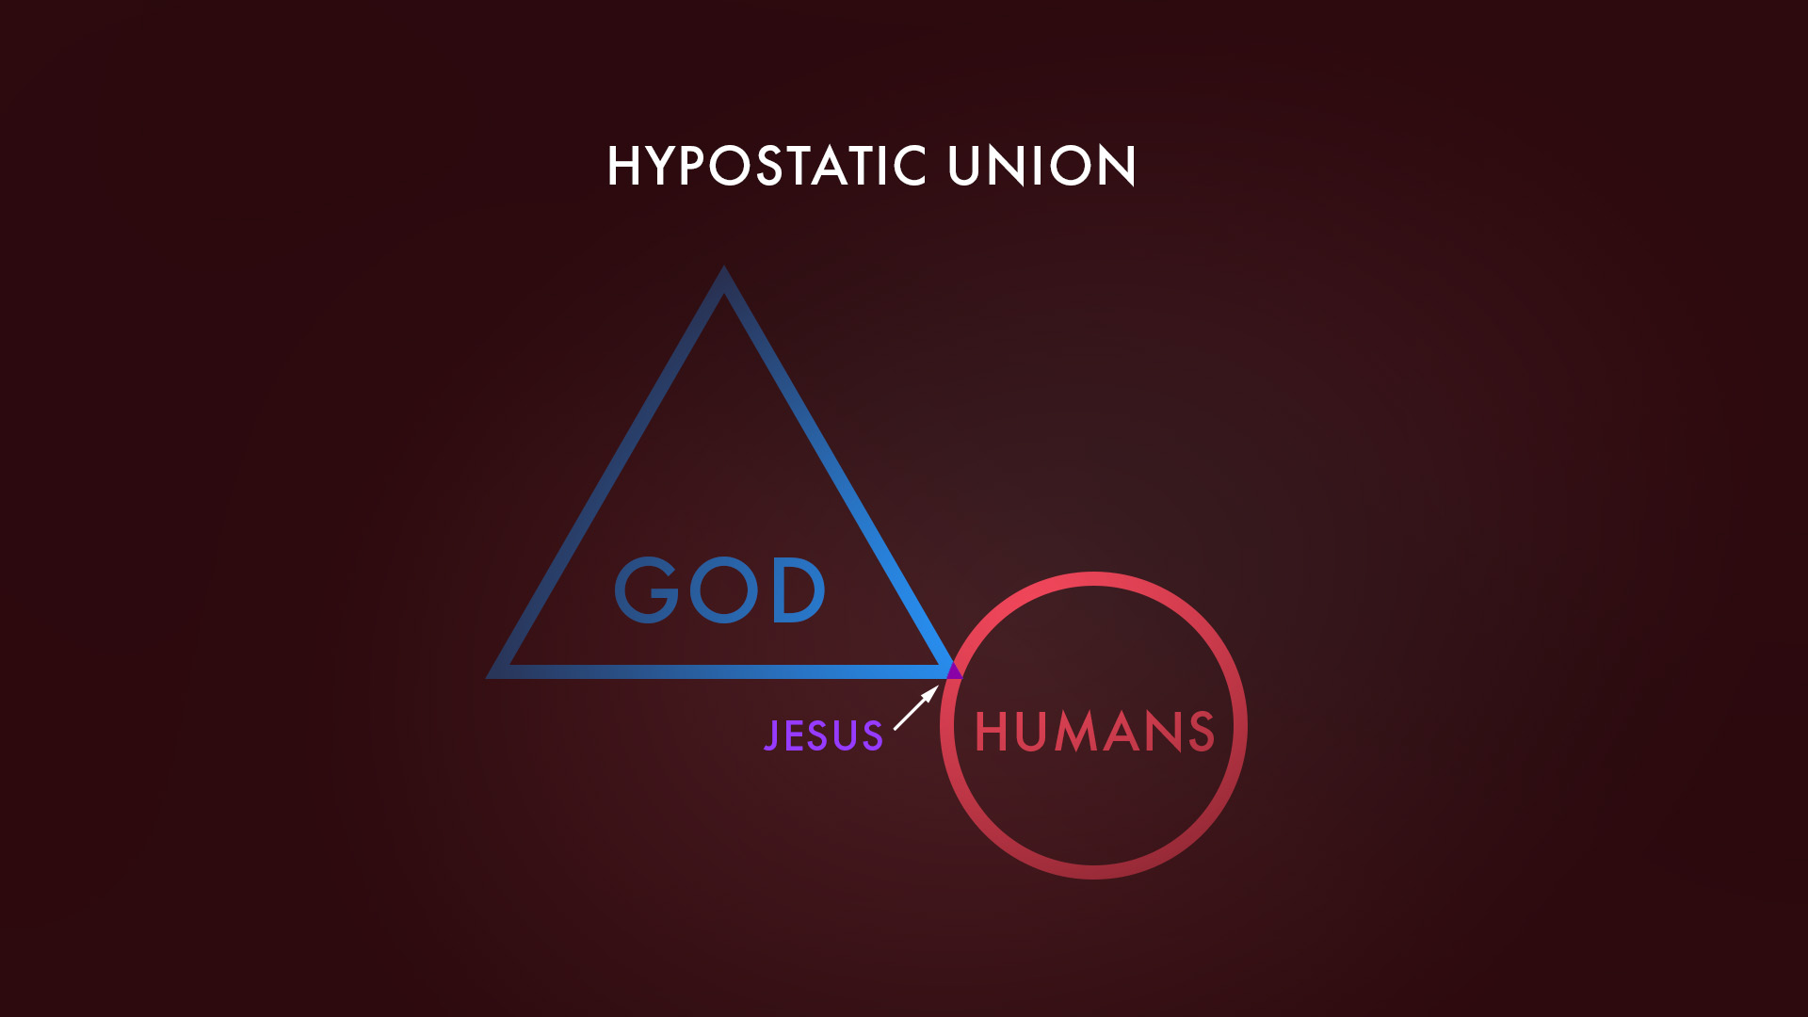

Slide 19
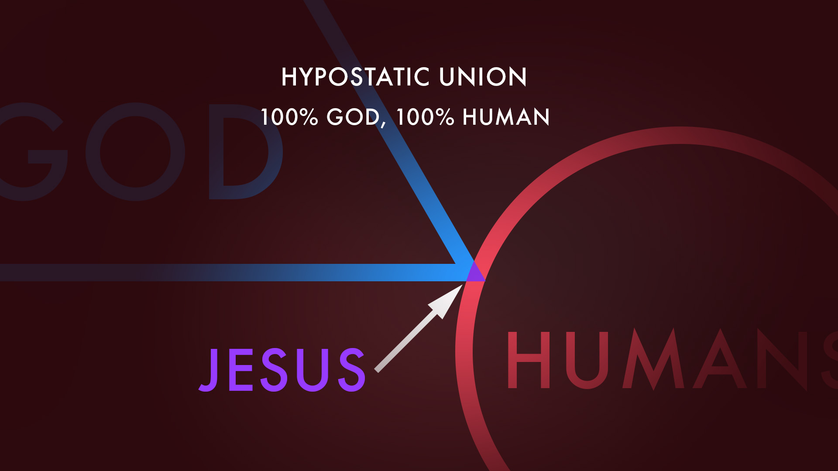

Slide 20
The Original Context (when to “shut the door”)
These deceivers were attacking a doctrine that is at the center of Christianity (Christology).
These deceivers are out to win an audience and convince people about their view of Christ.

Slide 21
The Original Context (when to “shut the door”)
These deceivers were attacking a doctrine that is at the center of Christianity (Christology).
These deceivers are out to win an audience and convince people about their view of Christ.
This passage has nothing to do with interacting with people of different faiths in a pluralistic culture.

Slide 22
What is this letter about?
This letter teaches us that
love and truth go together.

Slide 23
¹ The elder, To the lady chosen by God and to her children, whom I love in the truth—and not I only, but also all who know the truth— ² because of the truth, which lives in us and will be with us forever: ³ Grace, mercy & peace from God the Father and from Jesus Christ, the Father’s Son, will be with us in truth and love. ⁴ It has given me great joy to find some of your children walking in the truth, just as the Father commanded us.
2 John 1:1-4 (NIV)

Slide 24
What is truth?

Slide 25
Truth translates ἀλήθεια (alētheia).
From the root λήθω (lēthō), meaning “to conceal”
or “be hidden.” ἀ + λήθε + ια means “not concealed”.
Truth indicates the quality or state of being genuine.
Lexham Theological Wordbook

Slide 26
⁶ Jesus answered, “I am the way and the truth and the life. No one comes to the Father except through me.
John 14:6 (NIV)

Slide 27
¹⁵ “If you love me, keep my commands. ¹⁶ And I will ask the Father, and he will give you another advocate to help you and be with you forever—
¹⁷ the Spirit of truth. The world cannot accept him, because it neither sees him nor knows him. But you know him, for he lives with you and will be in you.
John 14:15-17 (NIV)

Slide 28
¹ The elder, To the lady chosen by God and to her children, whom I love in the truth—and not I only, but also all who know the truth— ² because of the truth, which lives in us and will be with us forever: ³ Grace, mercy & peace from God the Father and from Jesus Christ, the Father’s Son, will be with us in truth and love. ⁴ It has given me great joy to find some of your children walking in the truth, just as the Father commanded us.
2 John 1:1-4 (NIV)

Slide 29
What is truth?
Truth is the person of Jesus and
walking in genuine obedience to Jesus
by the power of the Holy Spirit.

Slide 30
What is love?
⁶ And this is love: that we walk in obedience to his commands. As you have heard from the beginning, his command is that you walk in love.
2 John 1:6 (NIV)

Slide 31
³⁴ “A new command I give you: Love one another.
As I have loved you, so you must love one another.
John 13:34 (NIV)
¹² My command is this: Love each other as I have loved you.
John 15:12 (NIV)

Slide 32
Love is not tolerance.

Slide 33
So what? How does this apply to us?

Slide 34
Lessons for Our Lives
Are we discerning people?

Slide 35
For a Book
Who is the author?
Where did they go to school?
Who is the publisher?
Who recommends this author?

Slide 36
For Videos of Influencers
Where were they trained?
Are they accountable to a board or organization?
Do they “major on the majors” and “minor on the minors”?
Are they saying something that no one else has ever said?

Slide 37
Alliance Theological Seminary
Asbury Theological Seminary
Bethel College
Dallas Theological Seminary
Denver Seminary
Fuller Theological Seminary
Gordon Conwell Theological Seminary
Hope College
Knox Theological Seminary
Moody Bible Institute
Reformed Theological Seminary
Regent College
Trinity Evangelical Divinity School
Wheaton College

Slide 38
Lessons for Our Lives
Are we discerning people?
Are we “continuing in the teaching?”

Slide 39
⁹ Anyone who runs ahead and does not continue
in the teaching of Christ does not have God; whoever continues in the teaching has both the Father and the Son.
2 John 1:9 (NIV)

Slide 40


Slide 41
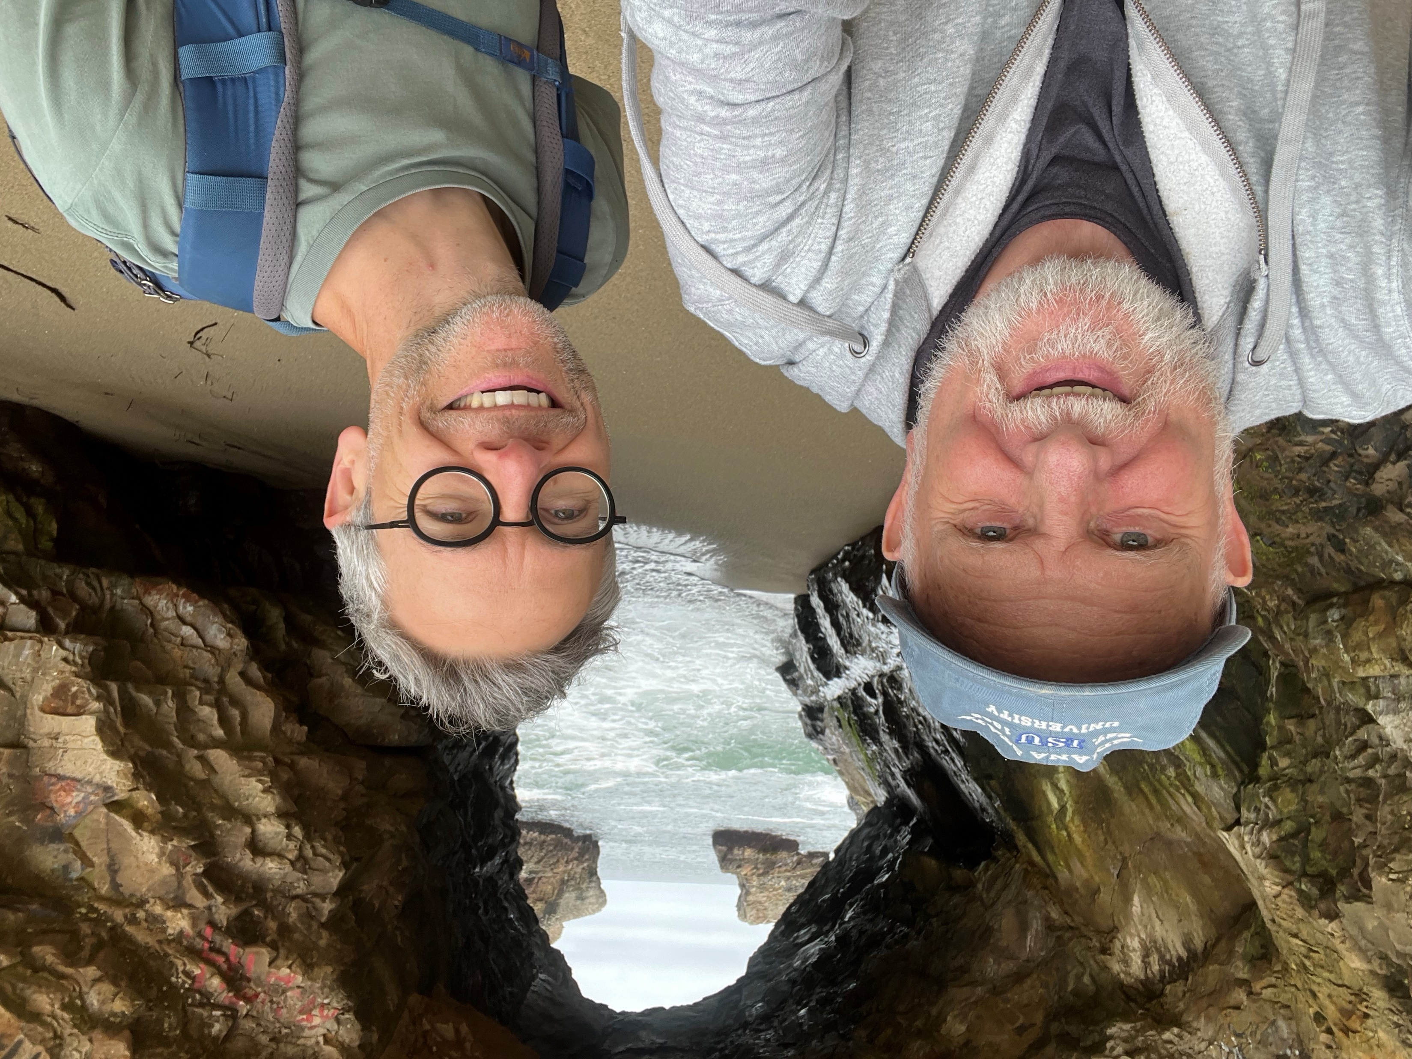

Slide 42


Slide 43


Slide 44
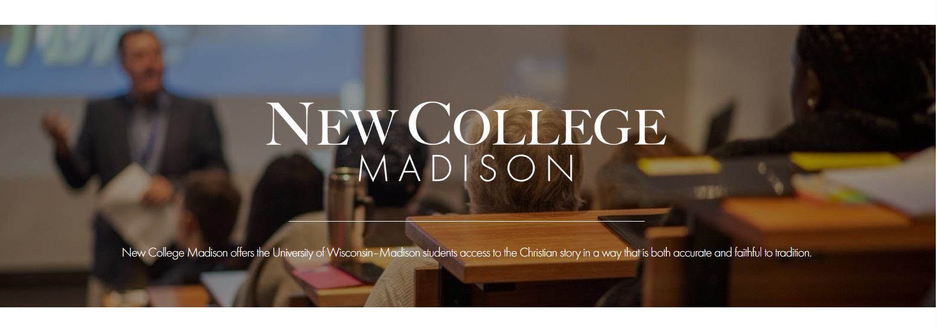

Slide 45
Lessons for Our Lives
Are we discerning people?
Are we “continuing in the teaching?”
Are we balanced?

Slide 46
“Our love grows soft if it is not strengthened by truth, and our truth hard if it is not softened by love. Scripture commands us both to love each other in the truth and to hold the truth in love.”
John Stott (pastor and theologian)

Slide 47
Truth without love is not truth.
Love without truth is not love.

Slide 48
³ Grace, mercy & peace from God the Father and from Jesus Christ, the Father’s Son, will be with us in truth and love.
2 John 1:3 (NIV)

